Slide 1
Algorithms for
Data Compression
[Unlocked] – chap 9
[CLRS] – chap 16.3

Slide 2
Outline
The Data compression problem
Techniques for lossless compression:
  Based on codewords
    Huffman codes
  Based on dictionaries
    Lempel-Ziv, Lempel-Ziv-Welch

Slide 3
The Data Compression Problem
Compression: transforming the way information is represented
Compression saves:
  space (external storage media)
  time (when transmitting information over a network)
Types of compression:
  Lossless: the compressed information can be decompressed into the original information
    Examples: zip
  Lossy: the decompressed information differs from the original, but ideally in an insignificant manner
    Examples: jpeg compression

Slide 4
Lossless compression
The basic principle for lossless compression is to identify and eliminate redundant information
Techniques used for codification:
  Codewords
  Dictionaries

Slide 5
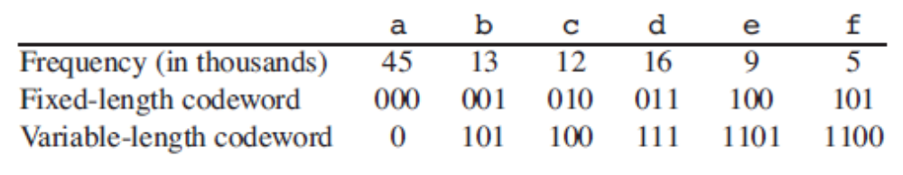
Codewords
Each character is represented by a codeword (an unique binary string)
  Fixed-length codes: all characters are represented by codewords of the same length (example: ASCII code)
  Variable-length codes: frequent characters get short codewords and unfrequent characters get longer codewords

Slide 6
Prefix Codes
A code is called a prefix code if no codeword is a prefix of any other codeword (actually “prefix-free codes” would be a better name)
This property is important for being able to decode a message in a simple and unambiguous way:
  We can match the compressed bits with their original characters as we decompress bits in order
  Example: 0 0 1 0 1 1 10 1 is unambiguosly decoded into aabe (assuming codes from previous table)

Slide 7
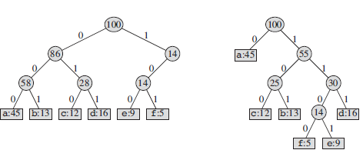
Representation of Prefix Codes
A binary tree whose leaves are the given characters. The codeword for a character is the simple path from the root to that character, where 0 means “go to the left child” and 1 means “go to the right child.”

Slide 8
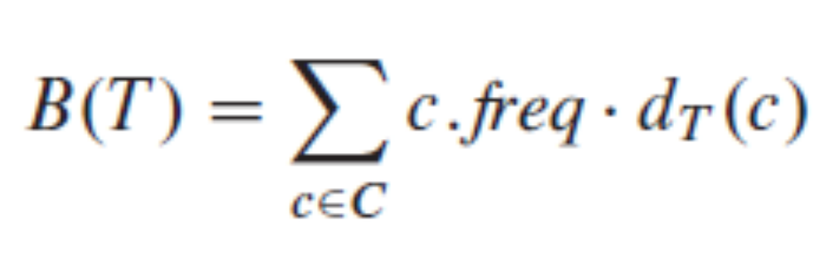
Constructing the optimal prefix code
Given a tree T corresponding to a prefix code, we can compute the number of bits B(T) required to encode a file.
For each character c in the alphabet C, let the attribute c.freq denote the frequency of c in the file and let d_{T}(c) denote the depth of c’s leaf in the tree.
The number of bits B(T) required to encode a file is the Cost of the tree:
B(T) should be minimal !

Slide 9
Huffmann algorithm for constructing optimal prefix codes
The principle of Huffman’s algorithm is following:
Input data: frequencies of the characters to be encoded
The binary tree is built bottom->up
We have a forest of trees that are united until one single tree results
Initially, each character is its own tree
Repeatedly find the two root nodes with lowest frequencies, create a new root with these nodes as its children, and give this new root the sum of its children frequencies

Slide 10
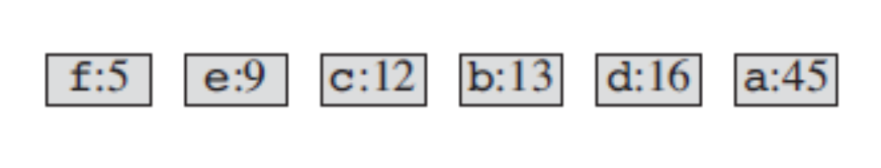
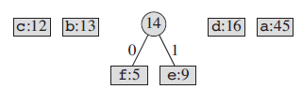
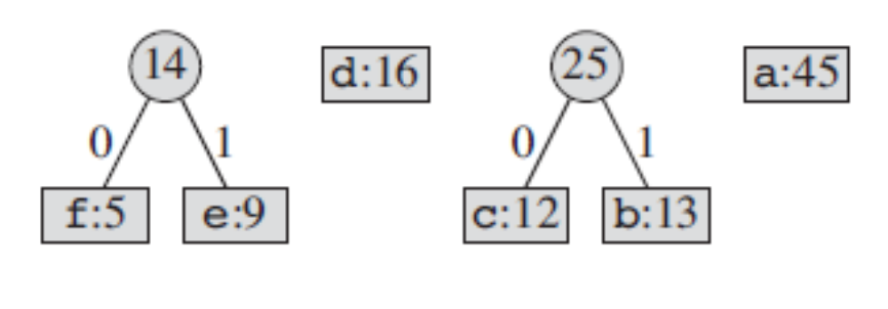
Example - Huffman
Step1:
Step2:
Step3:
[CLRS] – fig 16.5

Slide 11
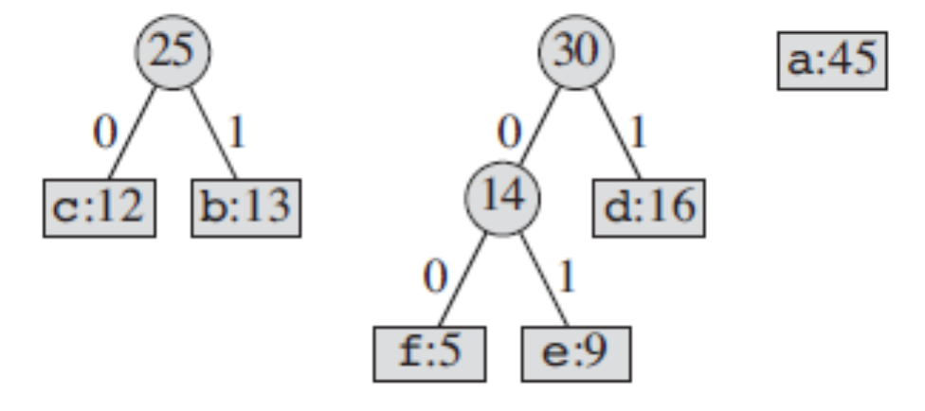
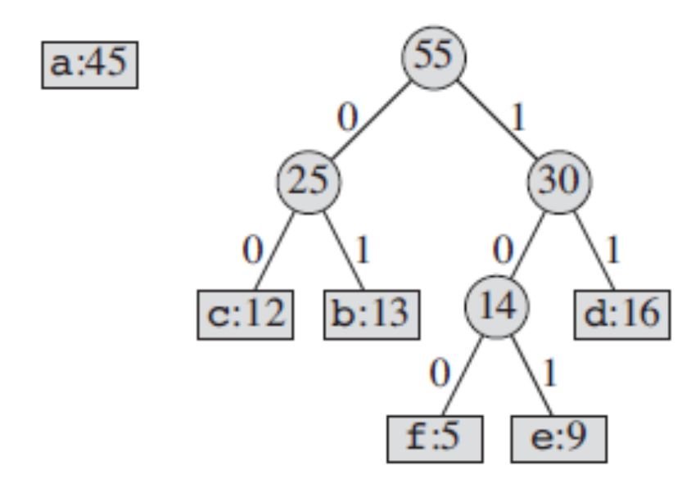
Example – Huffman (cont)
Step 4:
Step 5:
[CLRS] – fig 16.5

Slide 12
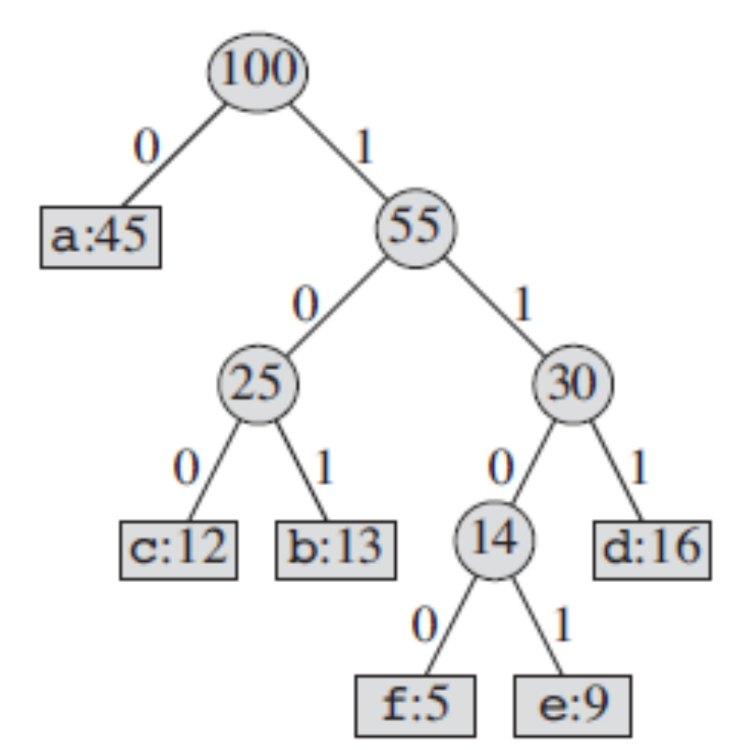
Example – Huffman (final)
Step 6:
[CLRS] – fig 16.5

Slide 13
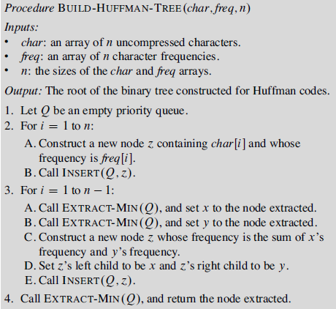
[Unlocked, chap 9, pg 164]

Slide 14
Huffman encoding
Input: a text, using an alphabet of n characters
Output: a Huffman codes table and the encoded text
Preprocessing:
  Computing frequencies of characters in text (requires one full pass over the input text)
  Building Huffman codes
Encoding:
  Read input text character by character, replace every character by its code(=string of bits) and write output text

Slide 15
Huffman decoding
Input: a Huffman codes table and the encoded text
Output: the original text
Starting at the root of the Huffman tree, read one bit of the encoded text and travel down the tree on the left child(bit 0) or right child (bit 1) until arriving at a leaf. Write the decoded character (corresponding to the leaf) and resume procedure from the root.

Slide 16
Huffman encoding - Example
Input text: ABRACABABRA
Compute char frequencies: A=5, B=3, R=2, C=1
Build code tree:
11
0
1
A=5
6
0
1
3
B=3
0
1
C=1
R=2
Encoded text: 01110101000110111010 20 bits
Coding of orginal text with fixed-length code: 11*2=22 bits
Attention ! The output will contain the encoded text + coding information ! (in this small example, actual size of output will be bigger than input in this case)

Slide 17
Huffman decoding - Example
Input: coding information + encoded text
  A=5, B=3, R=2, C=1
  01110101000110111010
Build code tree:
11
0
1
A=5
6
0
1
3
B=3
0
1
C=1
R=2
Decoded text:
ABRACABABRA

Slide 18
Huffman coding in practice
Can be applied to compress as well binary files (characters = bytes, alphabet = 256 “characters”)
Codes = strings of bits
Implementing Encoding and Decoding involves bitwise operations !

Slide 19
Disadvantages of Huffman codes
Requires two passes over the input (one to compute frequencies, one for coding), thus encoding is slow
Requires storing the Huffman codes (or at least character frequencies) in the encoded file, thus reducing the compression benefit obtained by encoding
=> these disadvantages can be improved by Adaptive Huffman Codes (also called Dynamic Huffman Codes)

Slide 20
Principles of Adaptive Huffman
Encoding and Decoding work adaptively, updating character frequencies and the binary tree as they compress or decompress in just one pass

Slide 21
Adaptive Huffman encoding
The compression program starts with an empty binary tree.
While (input text not finished)
  Read character c from input
  If (c is already in binary tree) then
      Writes code of c
    Increases frequency of c
      If necessary updates binary tree
    Else
    Writes c unencoded ( + escape sequence)
    Adds c to the binary tree

Slide 22
Adaptive Huffman decoding
The decompression program starts with an empty binary tree.
While (coded input text not finished)
  Read bits from input until reaching a code or the escape sequence
  If (bits represent code of a character c) then
      Write c
    Increases frequency of c
      If necessary updates binary tree
    Else
    Read bits of new character c
    Write c
    Adds c to the binary tree

Slide 23
Adaptive Huffman
The main issue of Adaptive Huffman codes is to correctly and efficiently update the code tree when adding a new character or increasing the frequency of a character
  one cannot just run the Huffman algo for building the tree every time one frequency gets modified
Both the coder and the decoder use exactly the same algo for updating code trees (otherwise decoding will not work !)
Known solutions to this problem:
  FGK algorithm (Faller, Gallagher, Knuth)
  Vitter algorithm

Slide 24
Outline
The Data compression problem
Techniques for lossless compression:
  Based on codewords
    Huffman codes
  Based on dictionaries
    Lempel-Ziv, Lempel-Ziv-Welch

Slide 25
Dictionary-based encoding
Dictionary-based algorithms do not encode single symbols as variable-length bit strings; they encode variable-length strings of symbols as single tokens
  The tokens form an index into a phrase dictionary
  If the tokens are smaller than the phrases they replace, compression occurs.

Slide 26
Dictionary-based encoding example
Dictionary:
ASK
NOT
WHAT
YOUR
COUNTRY
CAN
DO
FOR
YOU
Original text:
ASK NOT WHAT YOUR COUNTRY CAN DO FOR YOU ASK WHAT YOU CAN DO FOR YOUR COUNTRY
Encoded based on dictionary :
1 2 3 4 5 6 7 8 9 1 3 9 6 7 8 4 5

Slide 27
Dictionary-based encoding in practice
Problems in practice:
  Where is the dictionary ? (external/internal) ?
  Dictionary is known in advance (static) or not ?
  Size of dictionary is large -> size of dictionary index word may be comparable or bigger than some words
    If index word is on 4 bytes => dictionary may hold 2³² words

Slide 28
LZ-77
Abraham Lempel & Jacob Ziv: 1977: proposed a dictionary-based approach for compression
  Idea:
    dictionary is actually the text itself
    First occurrence of a “word” in input => “word” is written in output
    Next occurences of a “word” in input => instead of writing “word” in output, write only a “reference” to its first occurrence
  “word”: any sequence of characters
  “reference”: A match is encoded by a length-distance pair, meaning: "the next length characters are equal to the characters exactly distance characters behind it in the input".

Slide 29
LZ-77 Principle Example
Input text:
IN_SPAIN_IT_RAINS_ON_THE_PLAIN
Coding:
IN_SPAIN_IT_RAINS_ON_THE_PLAIN
Coded output:
IN_SPA{3,6}IT_R{3,8}S_ON_THE_PL{3,22}

Slide 30
LZ-78 and LZW
Lempel-Ziv 1978
  Builds an explicit Dictionary structure of all character sequences that it has seen and uses indices into this dictionary to represent character sequences
Welch 1984 -> LZW
  The dictionary is not empty at start, but initialized with 256 single-character sequences (the ith entry is ASCII code i)
Notes:
Lempel–Ziv–Welch

Slide 31
LZW compressing principle
The compressor builds up strings, inserting them into the dictionary and producing as output indices into the dictionary.
The compressor builds up strings in the dictionary one character at a time, so that whenever it inserts a string into the dictionary, that string is the same as some string already in the dictionary but extended by one character. The compressor manages a string s of consecutive characters from the input, maintaining the invariant that the dictionary always contains s in some entry (even if s is a single character)

Slide 32
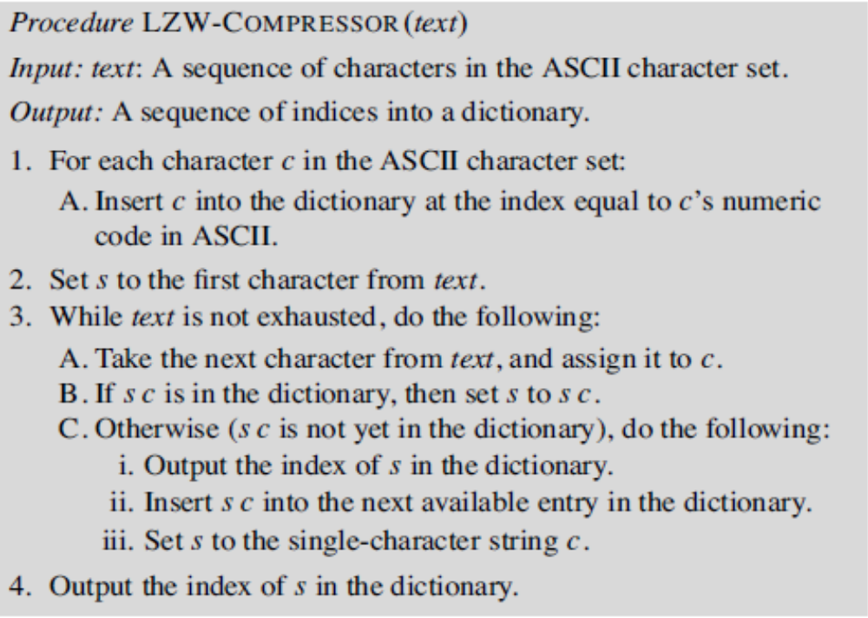
[Unlocked, chap 9, pg 172]

Slide 33
LZW Compressor Example
Input text: TATAGATCTTAATATA
Step 1: initialize dictionary with entries indices 0-255, corresponding to all ASCII characters
Step 2: s=T
Step 3:

Slide 34
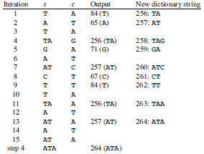
LZW Compressor Example (cont)
Input text: TATAGATCTTAATATA

Slide 35
LZW Decompressing principle
Input: a sequence of indices only.
The dictionary does not have be stored with the compressed information, LZW decompression rebuilds the dictionary directly from the compressed information !
Like the compressor, the decompressor seeds the dictionary with the 256 single-character sequences corresponding to the ASCII character set. It reads a sequence of indices into the dictionary as its input, and it mirrors what the compressor did to build the dictionary. Whenever it produces output, it’s from a string that it has added to the dictionary.

Slide 36
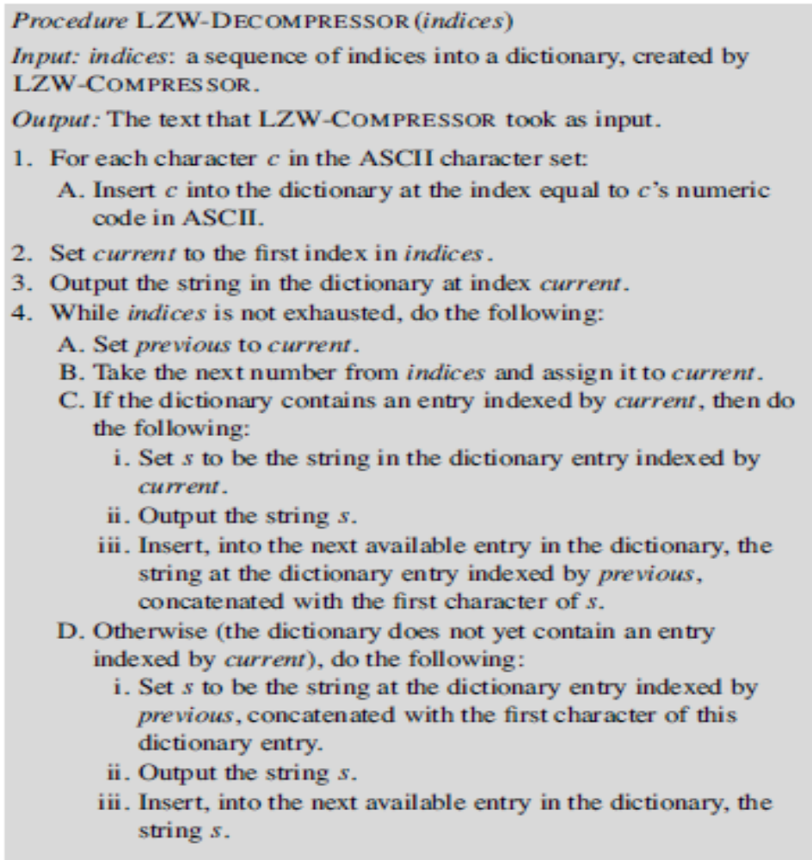
[Unlocked, chap 9]

Slide 37
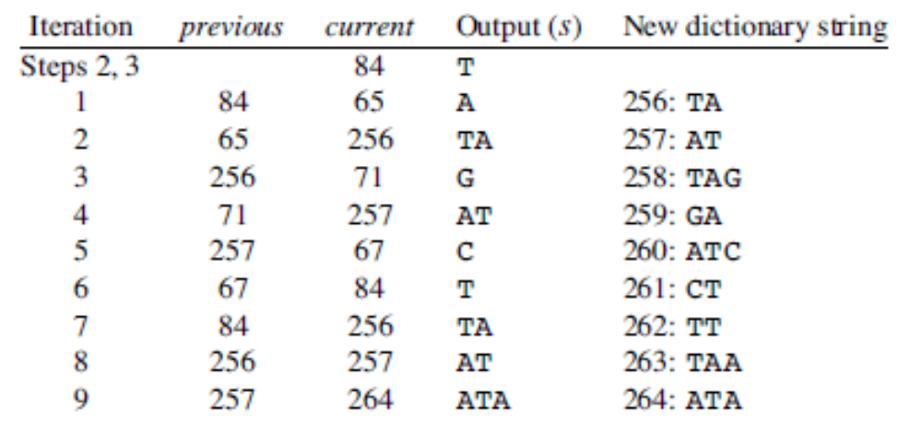
LZW Decompressor Example
Input: indices: 84, 65, 256, 71, 257, 67, 84, 256, 257, 264

Slide 38
LZW Implementation
Dictionary has to be implemented in an efficient way
  Trie trees
  Hashtables

Slide 39
Dictionary with Trie tree - Example
A
T
C
G
(65)
(67)
(71)
(84)
T
T
A
A
T
(257)
(261)
(259)
(256)
(262)
A
C
A
G
(264)
(260)
(263)
(258)
Words in dictionary: A, C, G, T, AT, CT, GA, TA, TT, ATA, ATC, TAA, TAG

Slide 40
LZW Efficiency
Biggest problem: size of dictionary is large => indices need several bytes to be represented => compression rate is low
Possible measures:
  Run Huffman encoding on LZW output (will work well because many indices in the LZW sequence are from the lower part)
  Limit size of dictionary
    once the dictionary reaches a maximum size, no other entries are ever inserted.
    In another approach, once the dictionary reaches a maximum size, it is cleared out (except for the first 256 entries), and the process of filling the dictionary restarts from the point in the text

Slide 41
Data compression in practice
Known file compression utilities:
  Gzip, PKZIP, ZIP: the DEFLATE approach( 2 phases compression, applying LZ77 and Huffman)
  Compress(UNIX distribution compressing tool ): LZW
Microsoft NTFS : a modified LZ77
Image formats:
  GIF: LZW
Fax machines: a modified Huffman encoding
LZ77: free to use => in open-source sw
LZ78, LZW: was protected by many patents

